Slide 1
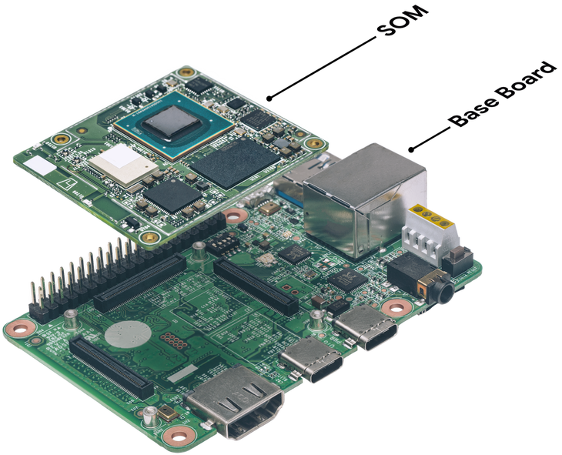

Slide 2
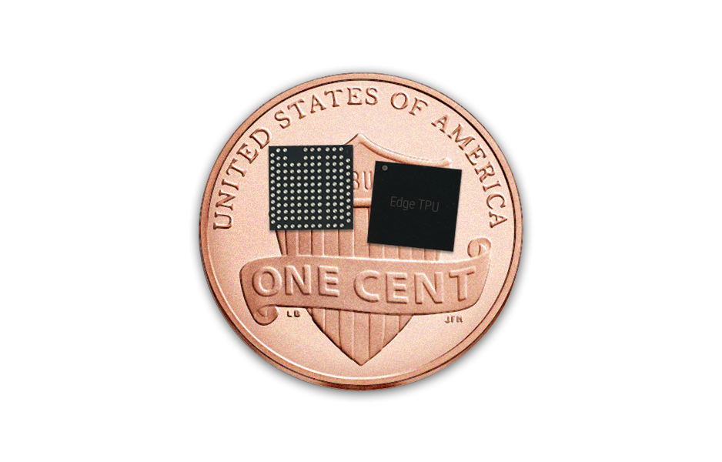

Slide 3
Myriad X vs Myriad 2
The Myriad X chip used on the AI CORE X is the successor to the Myriad 2 chip
 | Myriad 2 | Myriad X
Compute Capacity | >1 TOPS | >4 TOPS
Vector Processors | 12x SHAVE Processors | 16x SHAVE Processors
CPUs | 2x LEON4 cores (RISC; SPARC V8) | 2x LEON4 cores (RISC; SPARC V8)
On-chip Accelerators | ~20 image/vision processing accelerators | 20+ image/vision processing accelerators, Neural Compute Engine (DNN accelerator)
Neural Network Capability | 1st Gen DNN Support (Up to 100 GFLOPS) | Neural Compute Engine (Up to 1 TOPS)
On-chip Memory and Bandwidth | 2 MB (400 GB/sec) | 2.5 MB (450 GB/sec)
Video | VGA, 720p, 1080p, H.264 (software encoder) | M/JPEG 4K at 60 Hz encoder, H.264/H.265 4K at 30 Hz encoder
Process | 28 nm HPC+/HPC/HPM (TSMC) | 16 nm FFC (TSMC)

Slide 4
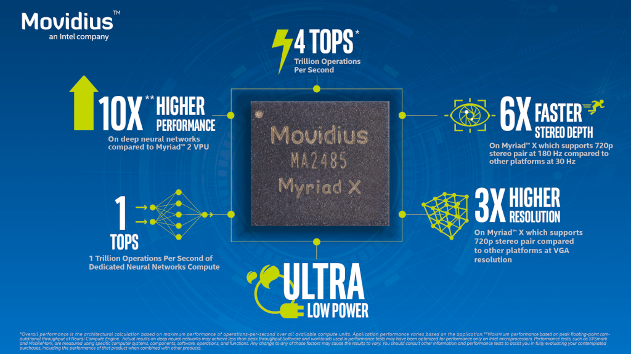

Slide 5
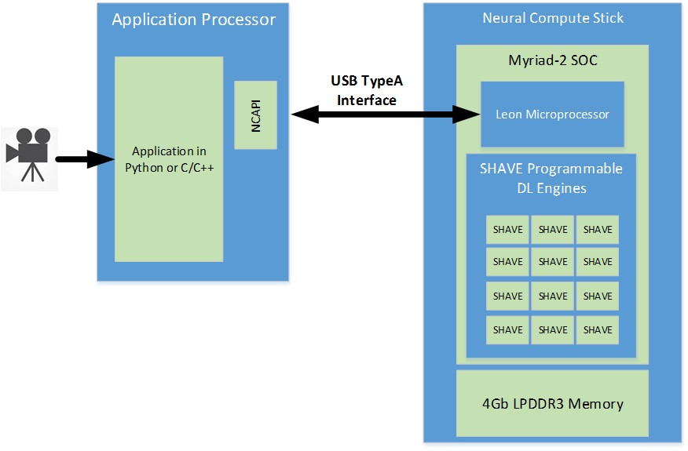

Slide 6
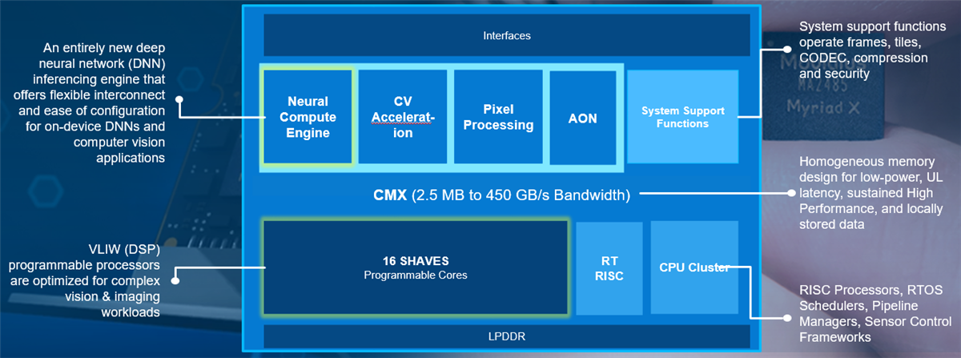

Slide 7
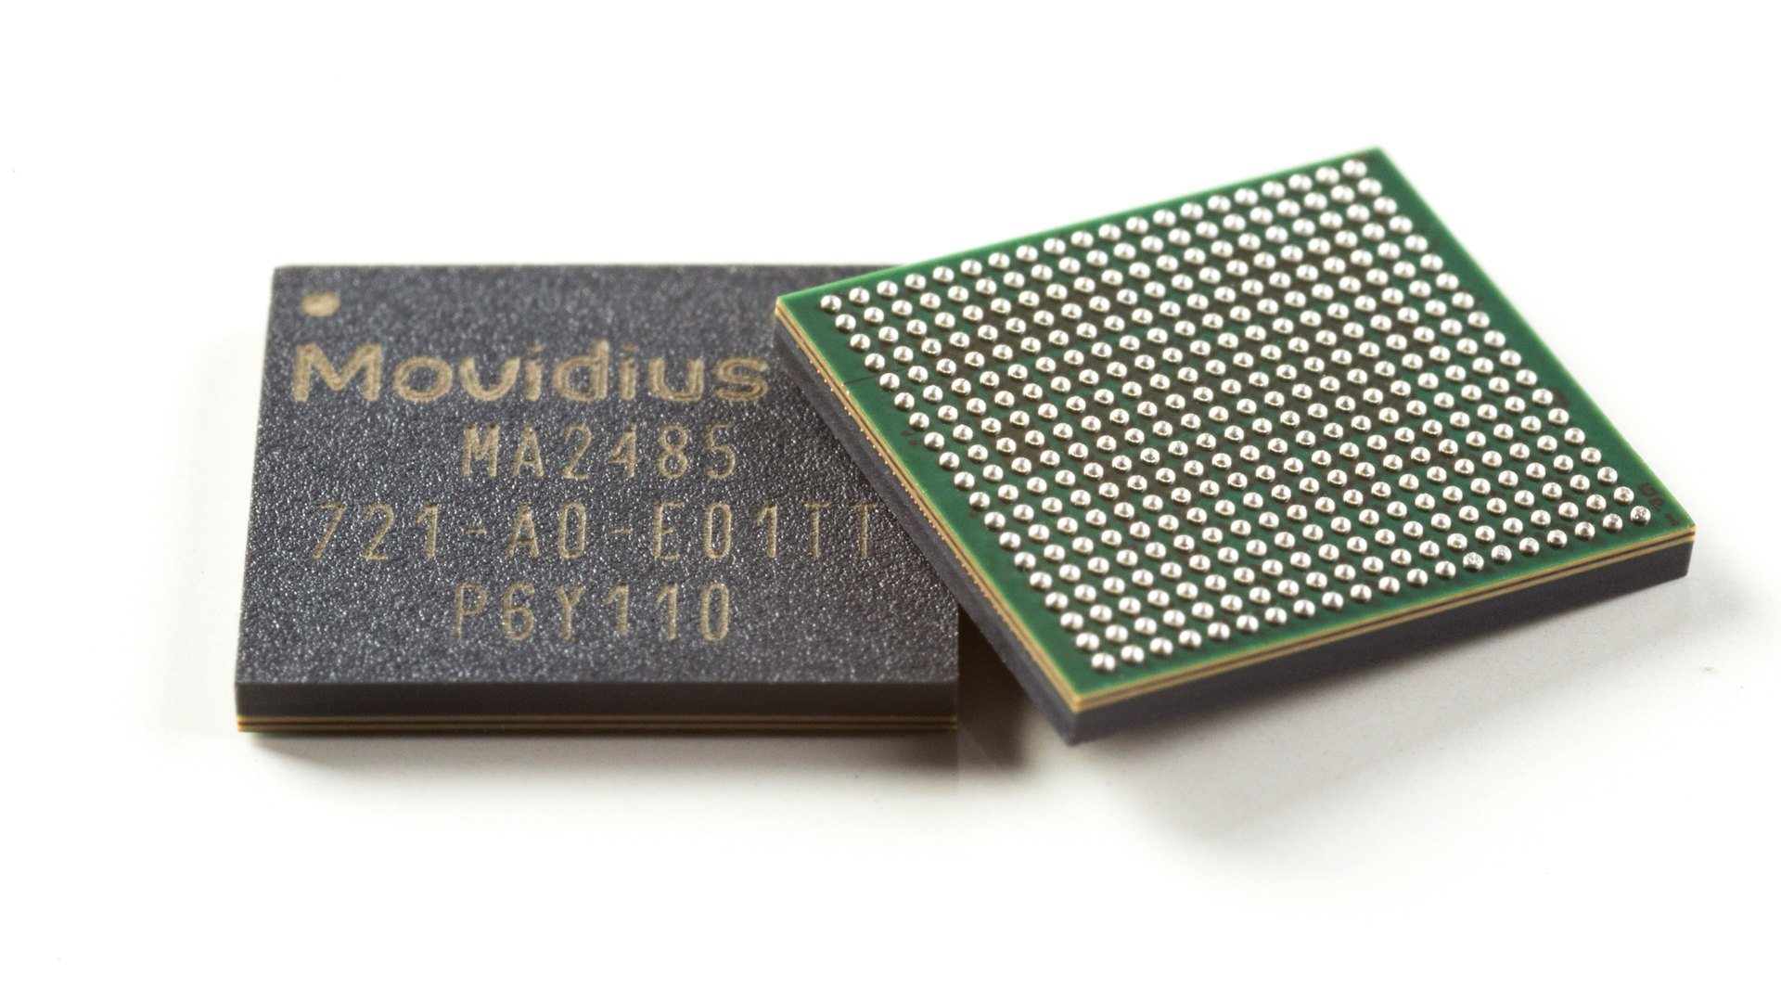

Slide 8
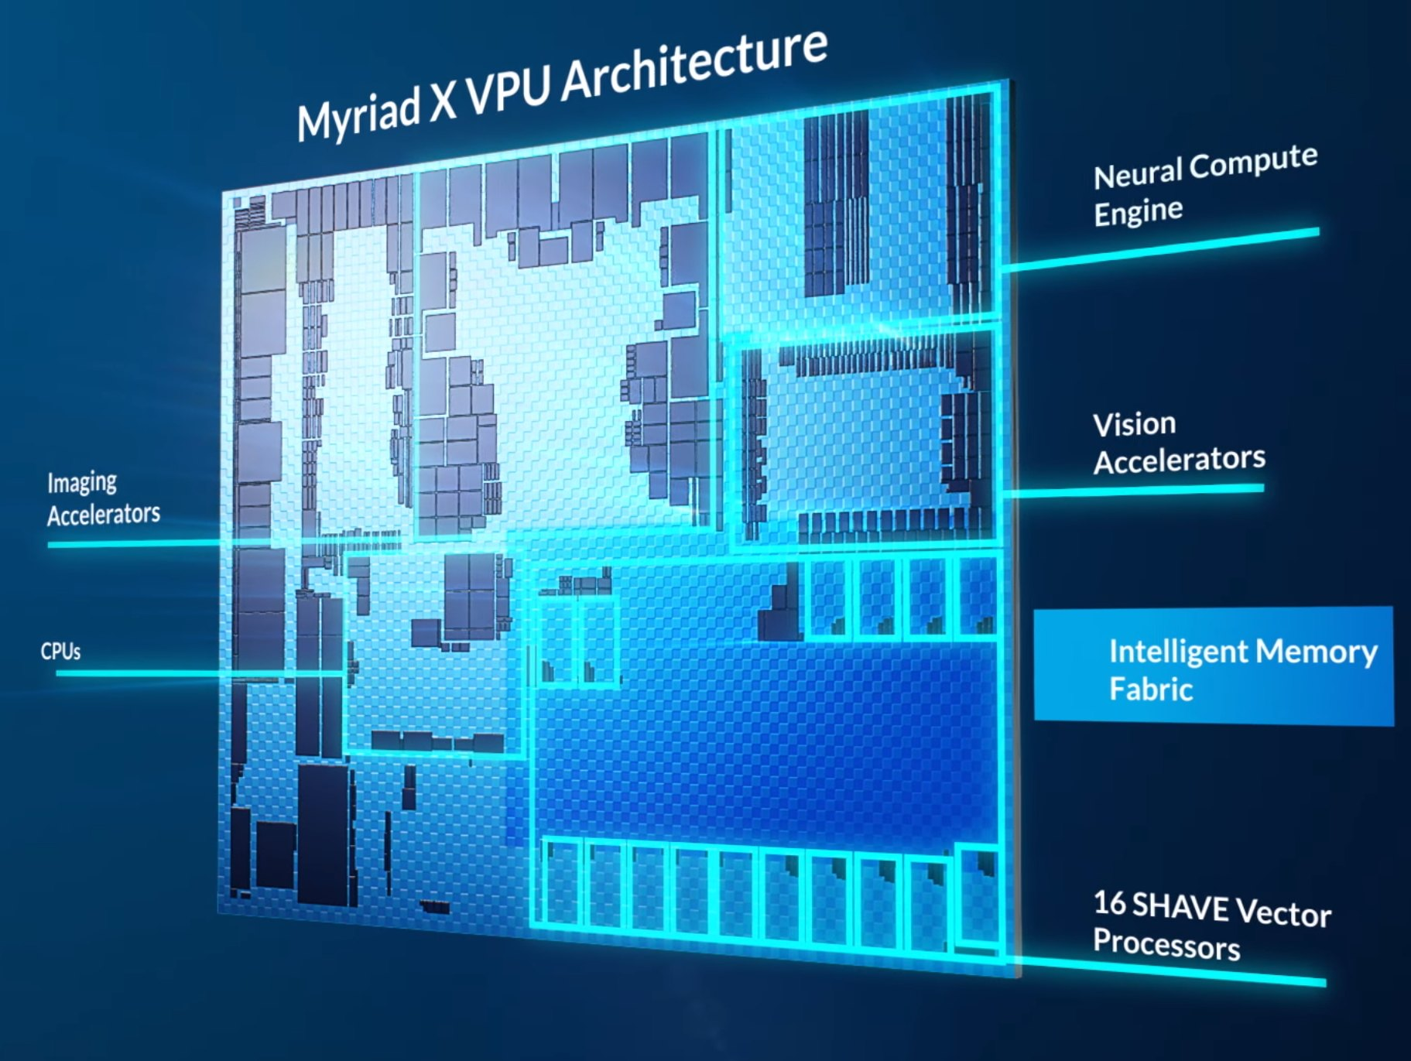

Slide 10
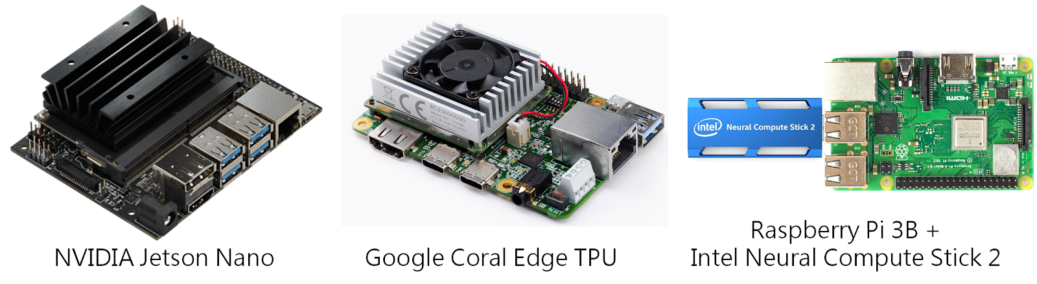

Slide 11
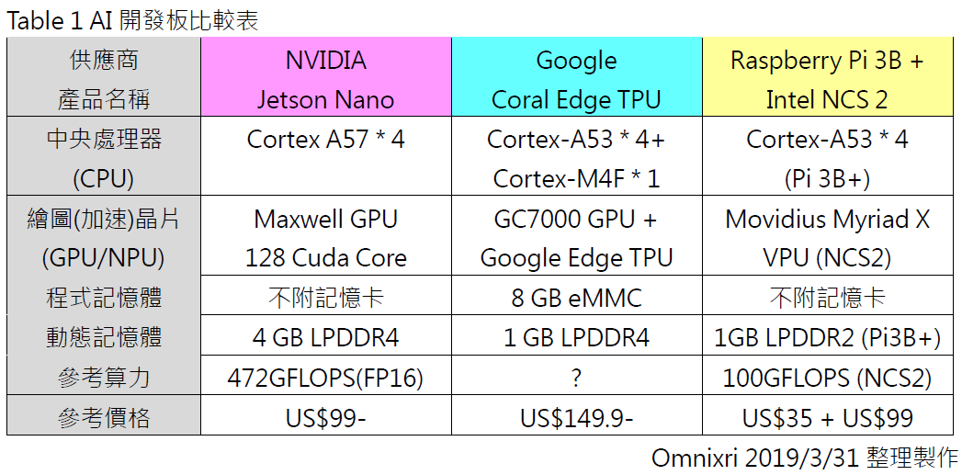

Slide 12
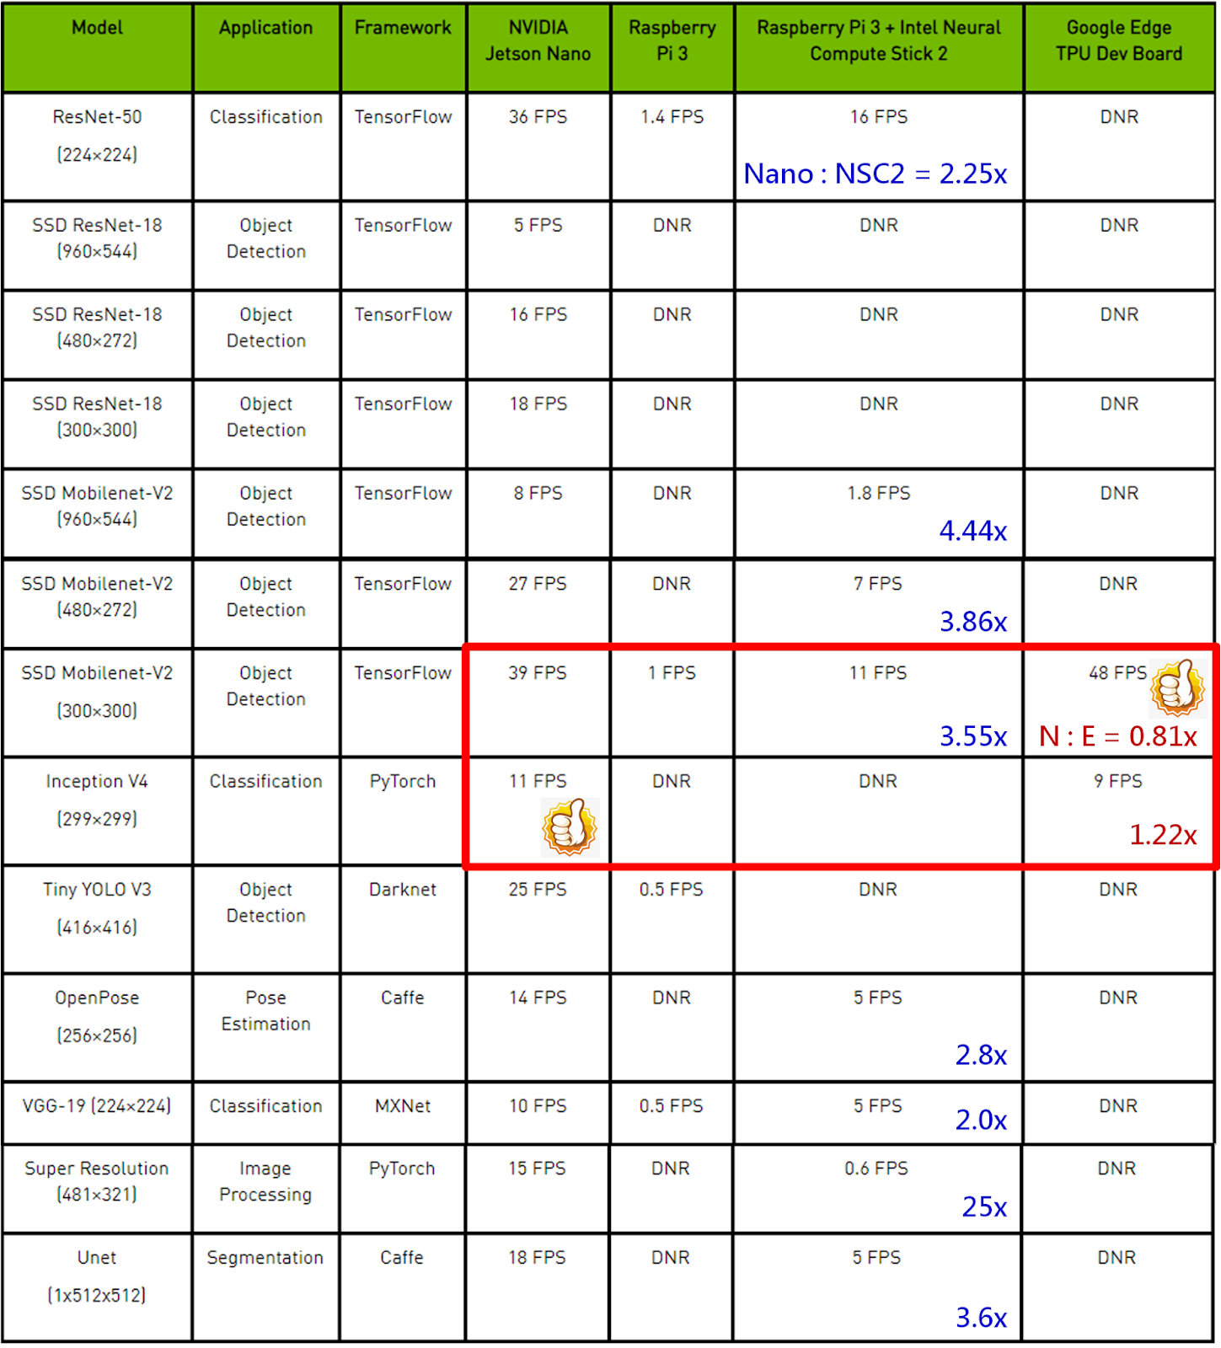

Slide 13
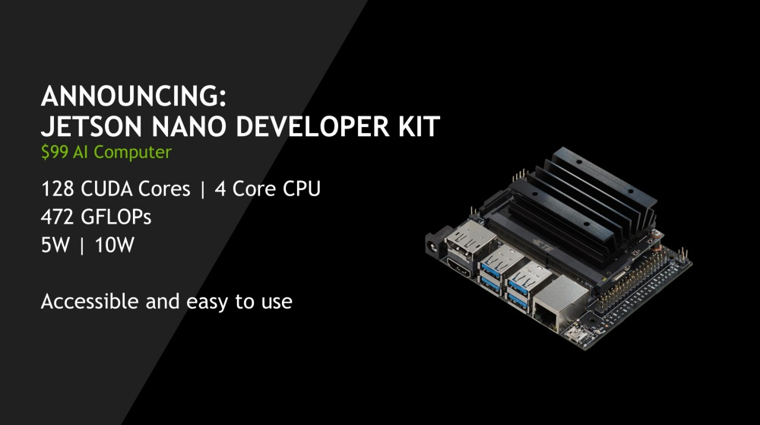

Slide 14


Slide 15
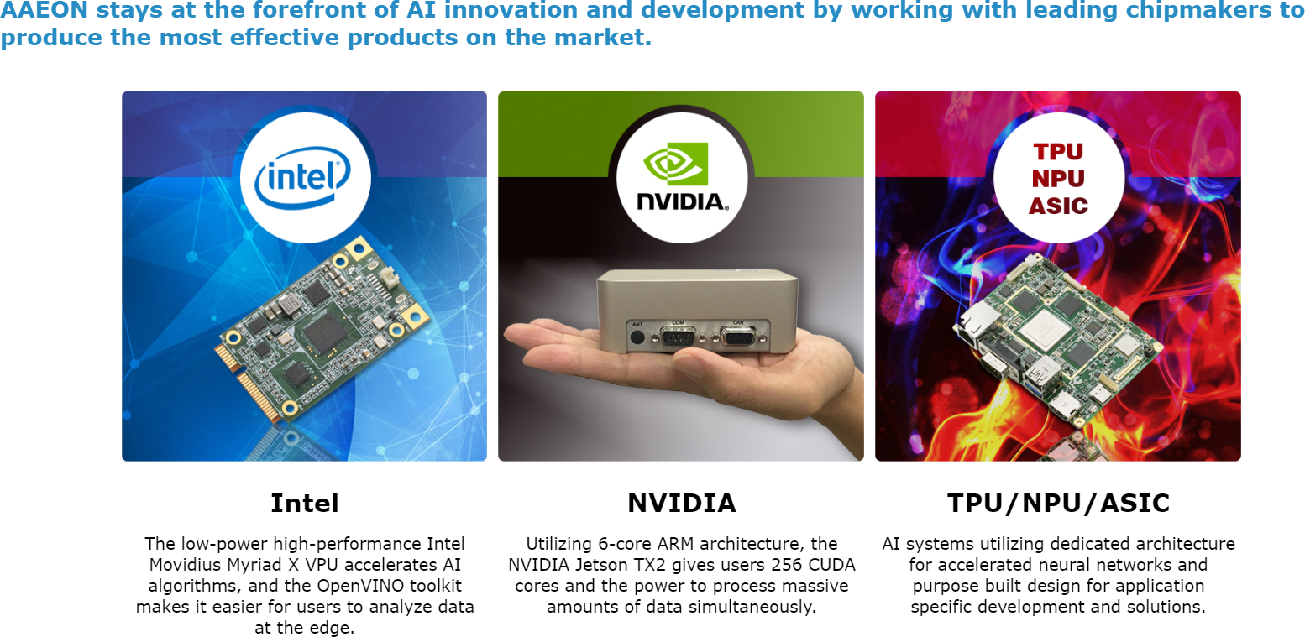

Slide 16
搶下新加坡智慧路燈標案，凌華成台灣唯一Google AI晶片Edge TPU合作廠

Slide 18
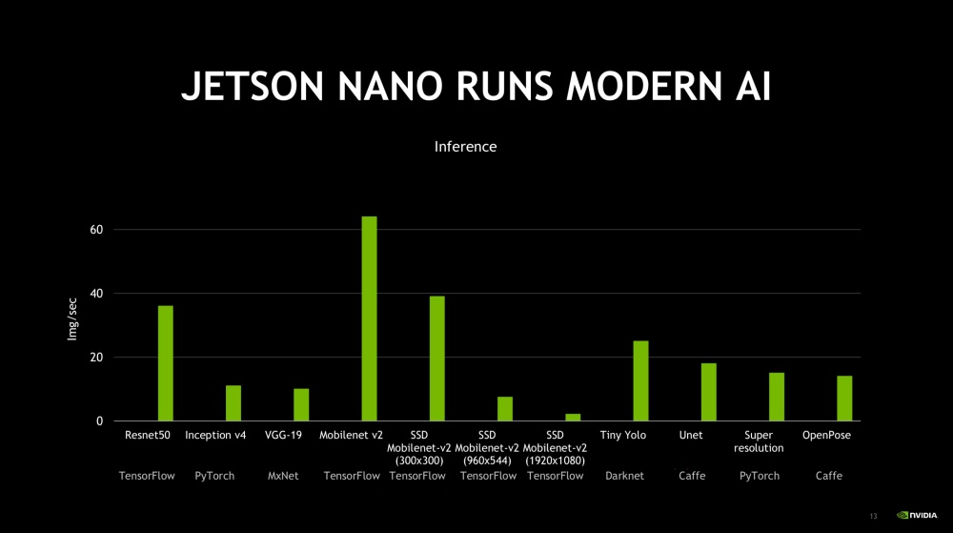

Slide 19
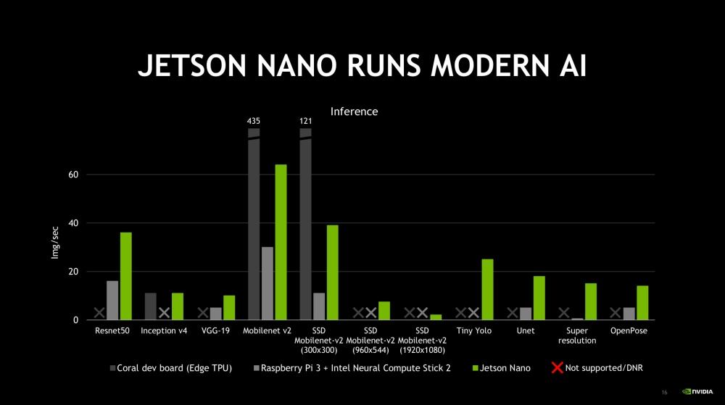

Slide 20
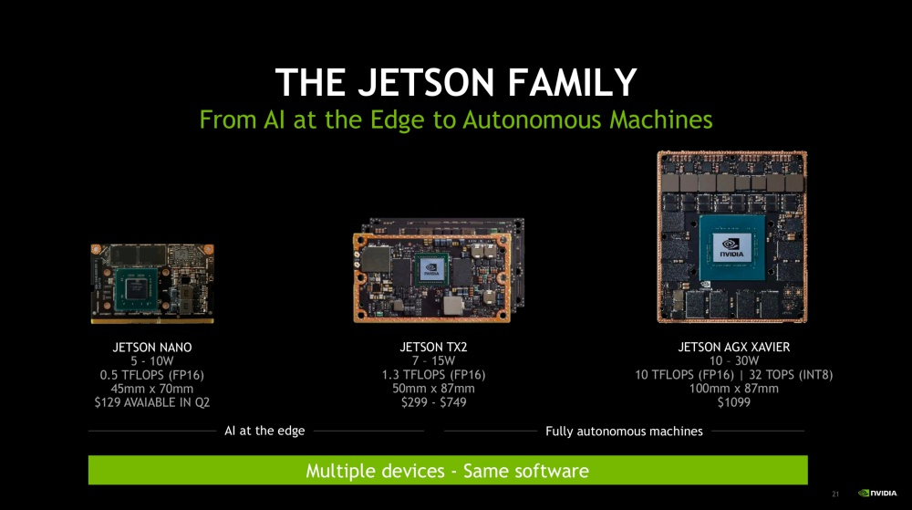

Slide 21
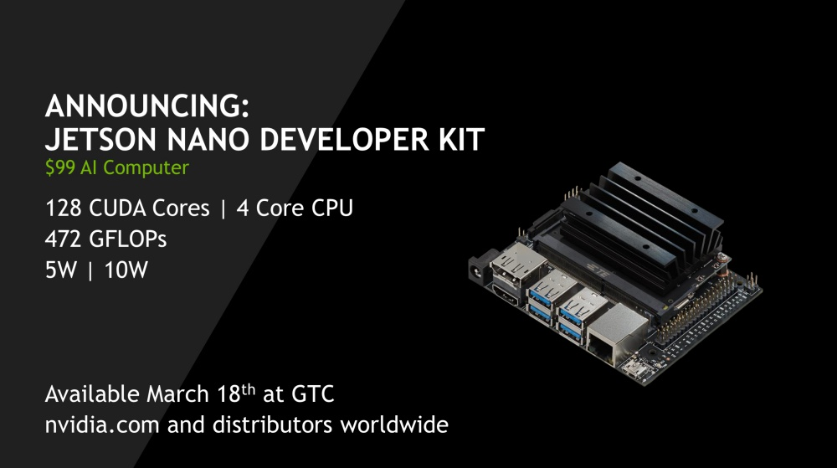

Slide 22
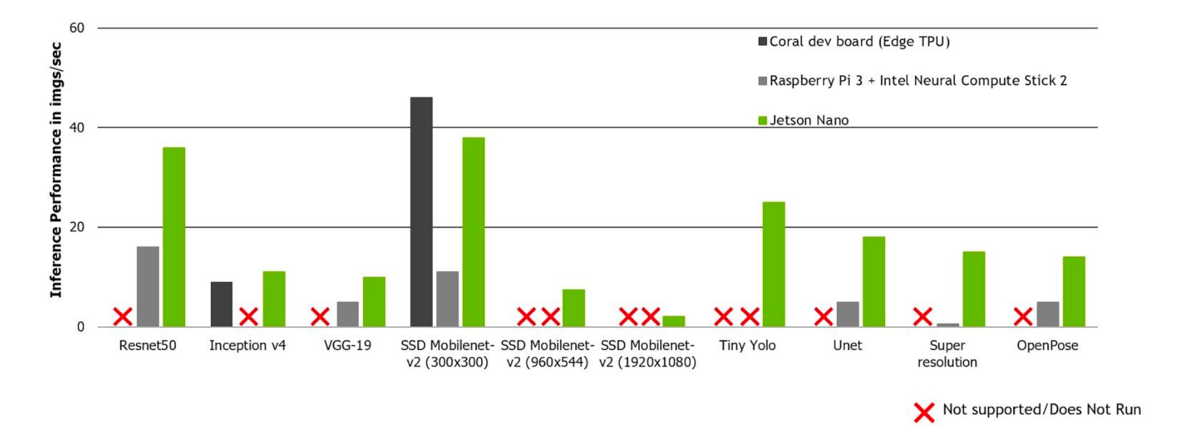

Slide 23
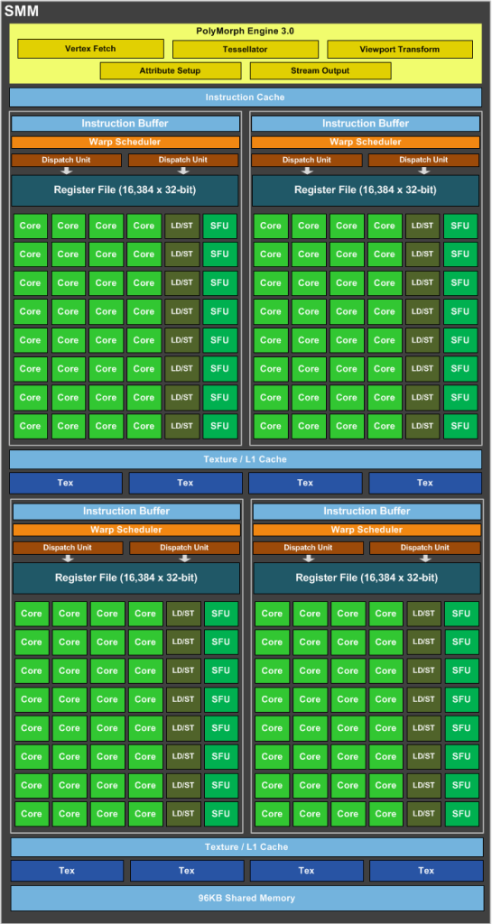

Slide 24
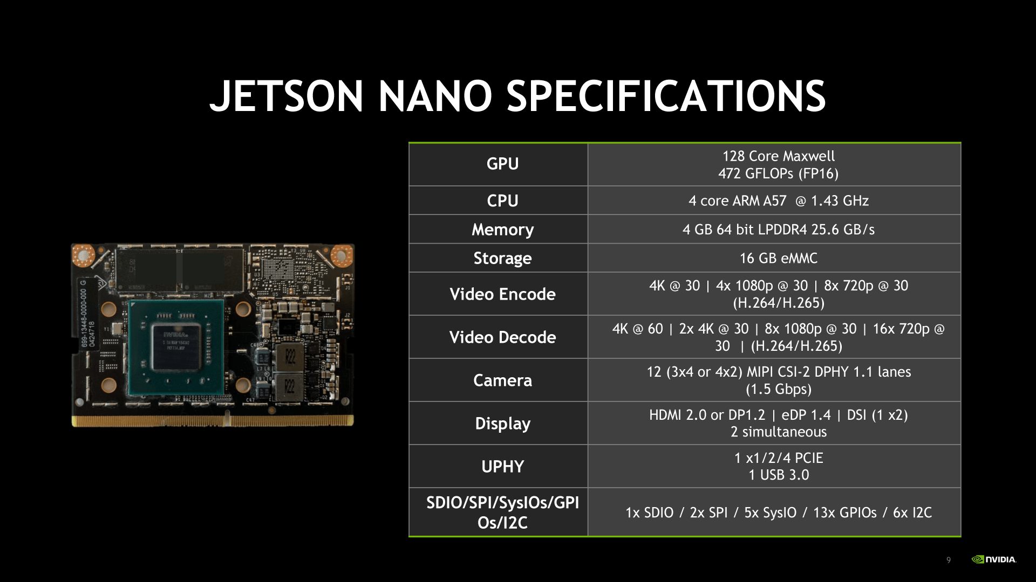

Slide 25
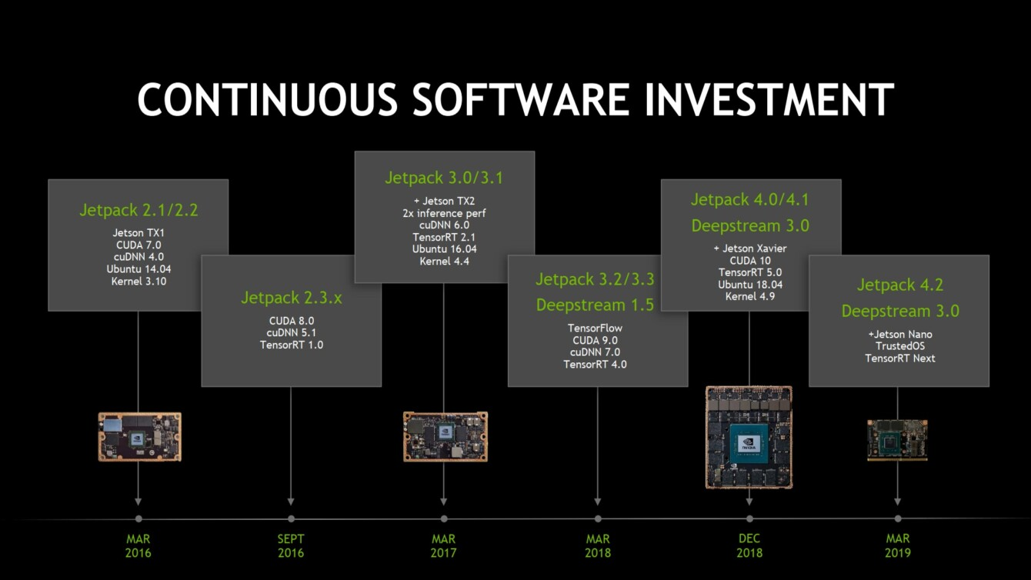

Slide 26
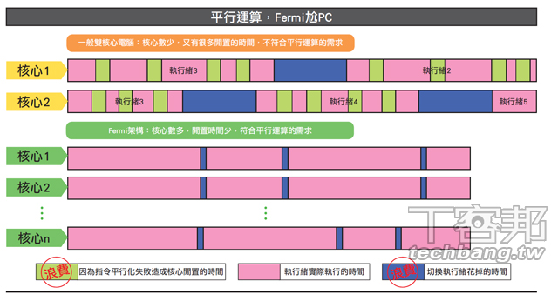

Slide 27
Nvidia
Tesla
Fermi
Kepler
Maxwell
Pascal
Volta
Turing

Slide 28
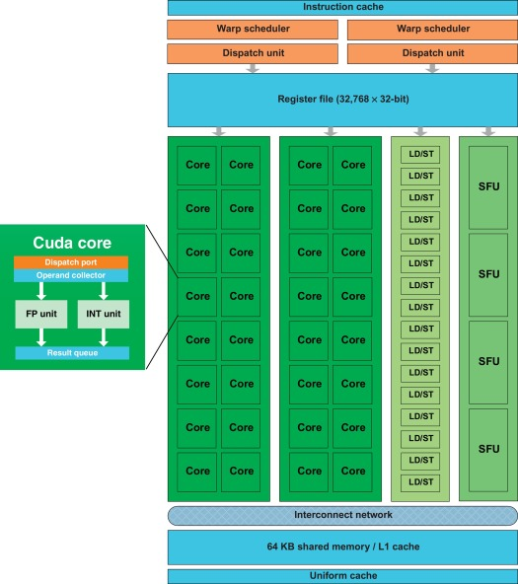

Slide 29
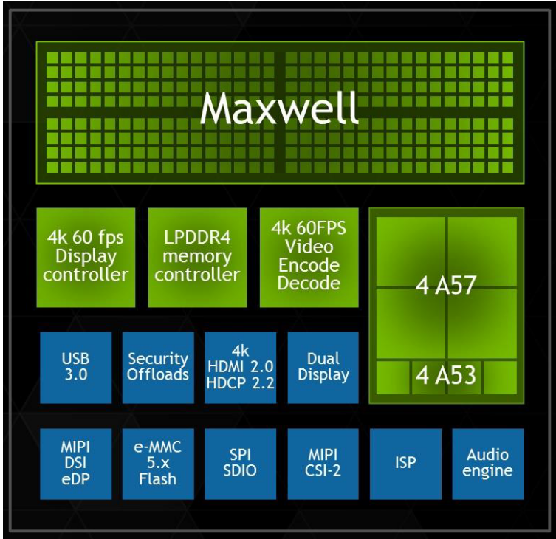

Slide 30
Figure 1 Jetson Nano Block Diagram
Jetson
3.3V Reg
Nano
Power
Subsystem
PMIC MAX77620
DC Jack
VDD_IN
* USB 2.0 x3
USB
RJ45 w/Magnetics
GBE_MDI
USB 3.0 x1
PCIe *
LPDDR4
4GB
* PCIe x4
PCIe x4
USB 2.0 *
CPU Reg uP1666
DSI, 2-lane
I2S *
eMMC
16GB
GPU Reg uP1666
eDP/DP
Connectivity
SDIO
Power Monitor
DP/HDMI
UART *
Gigabit
Ethernet
DP_AUX/DDC
Displays
GPIOs/Control
CEC, HPD x2
AUDIO MCLK
GPIOs/Control
I2S x2 *
CSI, 3 x4 lane
I2C x2–1.8V *
Tegra X1
* CAM I2C–3.3V
Cameras
Misc Expansion
I2C x2–3.3V *
CAM MCLK x2
SPI1 x2
GPIOs/Control
*
UART x3
* UART
Debug Serial
Port
GPIOs/Control
JTAG Test Points
NOTE:
Not all interfaces shown are available at same time; several interfaces are shown in multiple locations to illustrate different options. See the NVIDIA Jetson Nano OEM Product Design Guide and Pinmux Configuration Spreadsheet for supported options.

Slide 31
